Slide 1


Computer-Aided Design تراشه های منطقی برنامه پذیر
Mahdi Aminian
Some slides courtesy of:
CAD slides, Dr. Saheb Zamani
allaboutcircuits.com

Slide 2
Digital Circuits
Logic
Standard
Logic
ASIC
Programmable
Logic Devices
(FPLDs)
Gate
Arrays
Cell-Based
ICs
Full Custom
ICs
SPLDs
(e.g., PALs)
CPLDs
FPGAs
Microprocessor
& RAM
Acronyms
SPLD = Simple Programmable Logic Device
PAL = Programmable Array Logic
CPLD = Complex PLD
FPGA = Field Programmable Gate Array
ASIC = Application Specific IC
Common Resources
Configurable Logic Blocks (CLB)
Memory Look-Up Table (LUT)
AND-OR planes
Simple gates
Input / Output Blocks (IOB)
Bidirectional, latches, inverters, pullup/pulldowns
Interconnect or Routing
Local, internal feedback, and global

Slide 3
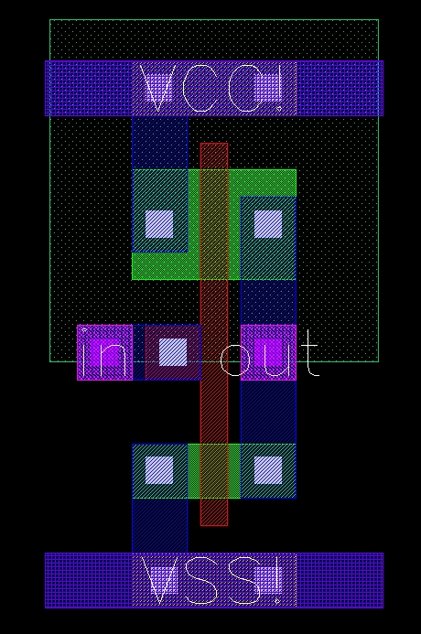
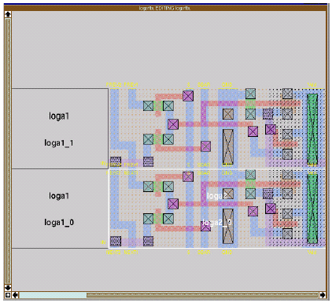
Full Custom

Slide 4
ASIC (Application Specific IC)
ASIC: Application-Specific Integrated Circuits
Semi-Custom ASIC:
Standard Cells
عناصر در رديفها چيده مي شوند
پورتها در بالا و پايين سلولها (تکنولوژي جديد: روي سلولها)
Gate Array
آرايه اي از سلولهاي مشابه
PLD (Programmable Logic Device)

Slide 5
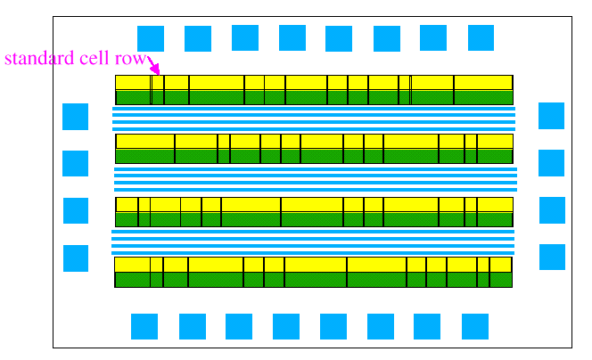
سلول های استاندارد
Wires
Adder
MUX
NAND

Slide 6
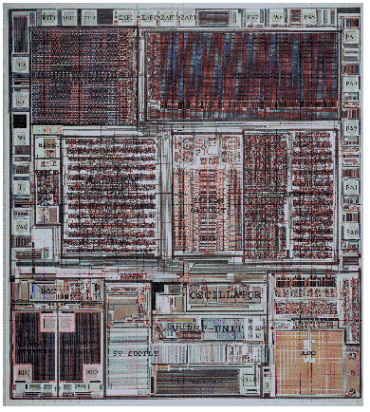
Mixed
Full custom & Standard cells
RAM/ROM
Row based Control Logic
Row based CPU

Slide 7
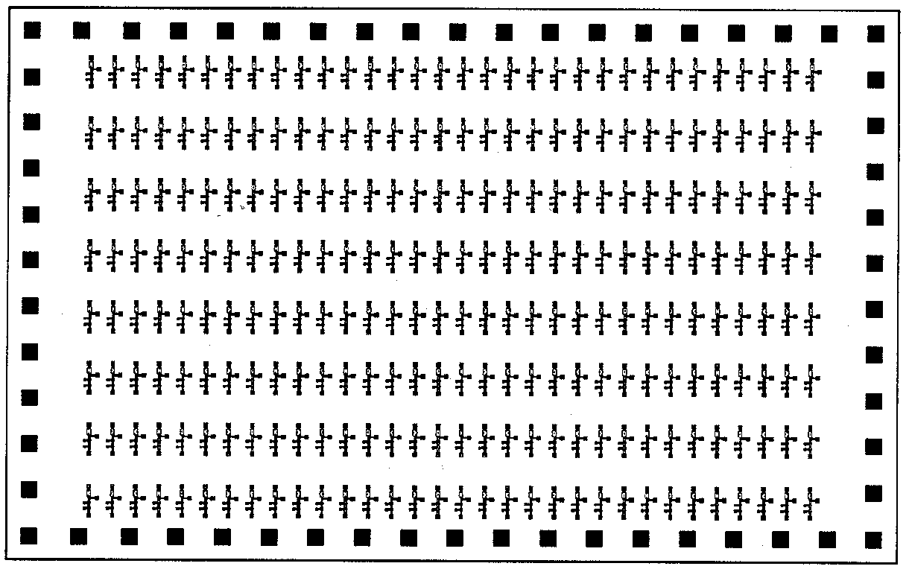
Gate Array (Uncommitted)
Using a prefabricated chip with active devices like NAND-gates
Later, interconnected according to a custom order by adding metal layers in the factory environment

Slide 8
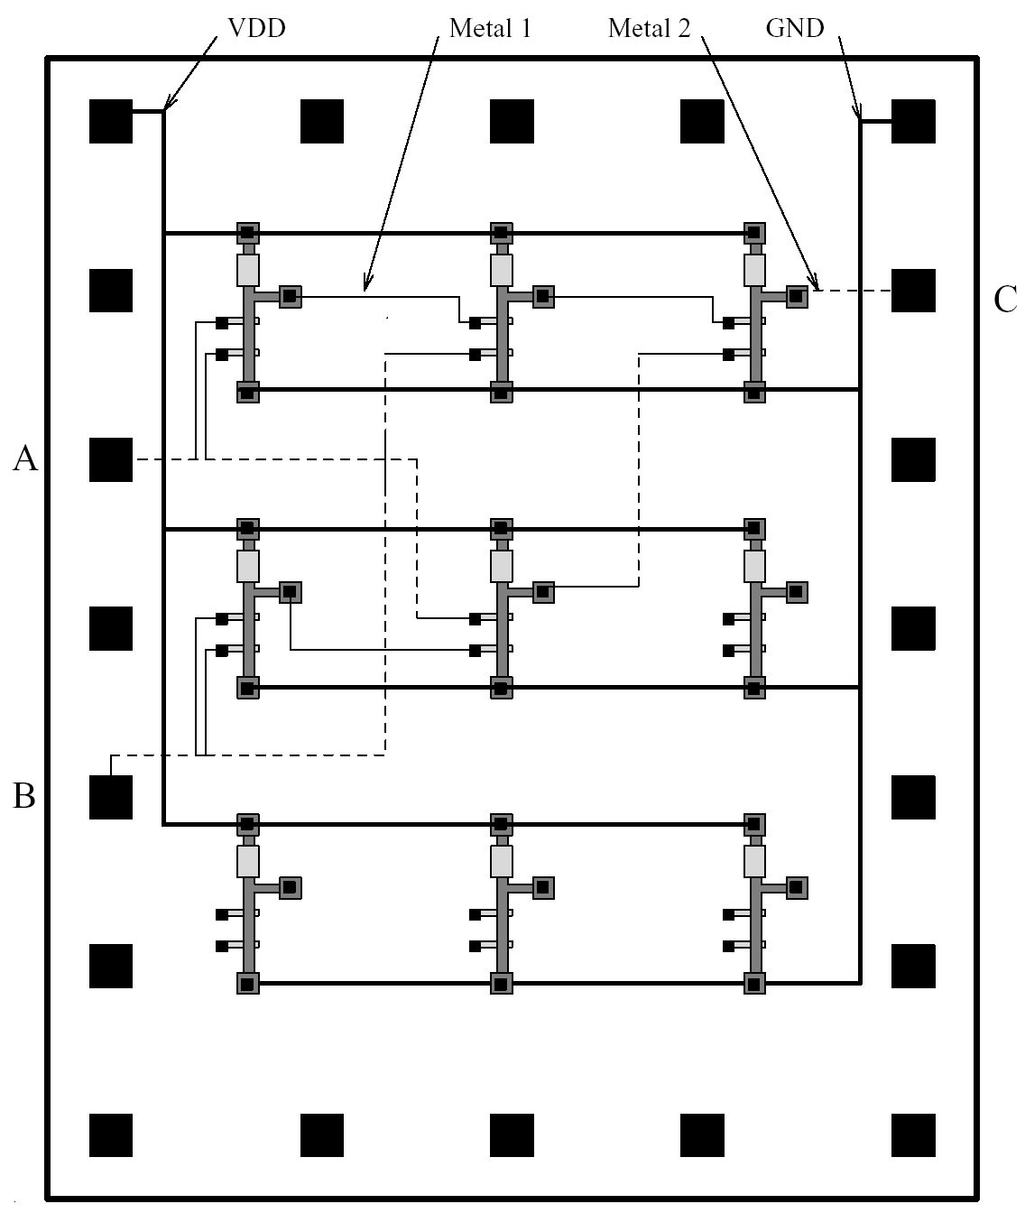
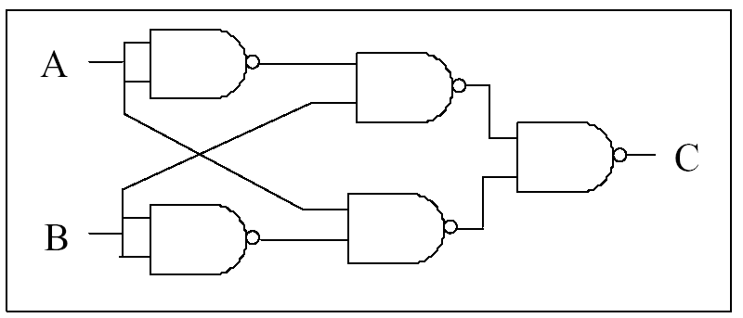
Gate Array (Committed)
MPGA: mask-programmed gate array
MPLD: mask-programmed logic device
A base of pre-designed transistors
Customized wiring during manufacturing process
→ Each design requires custom masks for wiring
Mask-making costs

Slide 9
Programmable Logic Device
A programmable logic device or PLD is an electronic component used to build digital circuits
Unlike a logic gate, which has a fixed function, a PLD has an undefined function at the time of manufacture
Before the PLD can perform in a circuit it must be programmed

Slide 10
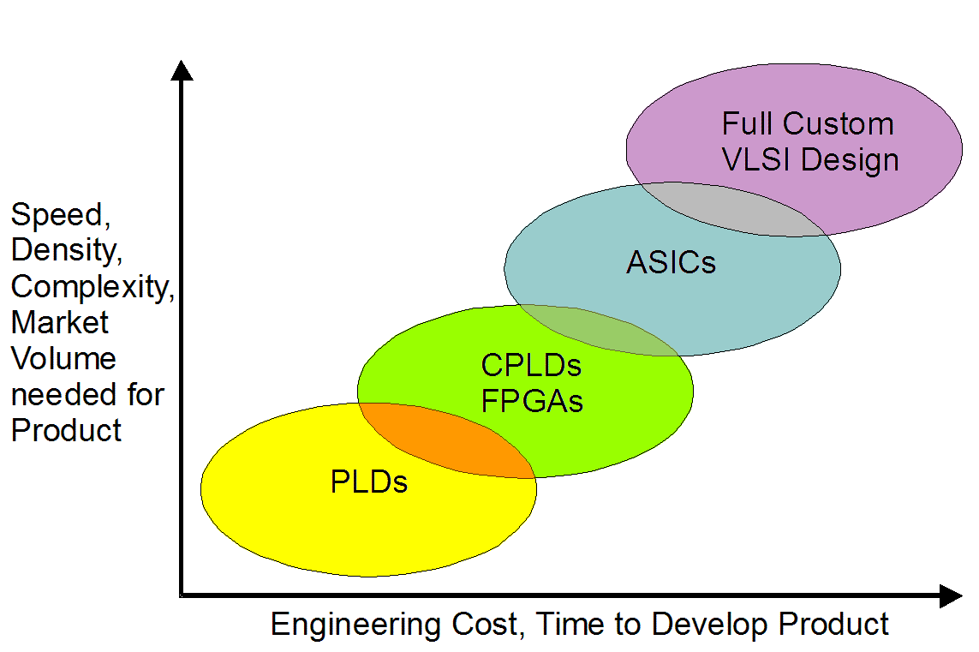
Digital Technology Tradeoffs
S
standard components
SSI/MSI
SPLD
CPLD FPGA
Gate
Std.
Full
Array
Cell
Custom
semicustom technologies

Slide 11
“Programmable”

Slide 12


“Programmable”?
One time programmable
Fuses
(destroy internal links with current)
Anti-fuses (grow internal links)
PROM
Reprogrammable
EPROM
EEPROM
Flash
SRAM → volatile
}
non-volatile

Slide 13
Antifuse
جريان برنامه ريزي بالا ← عايق ONO را ذوب مي کند ⬅ اتصال دايم.
به علت کوچکي، PLD هاي آنتي فيوز ظرفيت بسيار بالايي دارند.

Slide 14
Antifuse
مزايا:
عدم نياز به حافظه ي خارجي.
مساحت بسيارکم (تقريبا هم اندازه با viaي سيمهاي فلزي).
قابليت اطمينان بسيار بالا
(TDDB: Time-Dependent Dielectric Breakdown) حدود 40 سال.
مقاومت کم در حالت روشن (در طي زمان هم کم مي ماند).
خازن پارازيتي بسيار کمتر.
امنيت بالاي طرح در برابر سرقت.
توان مصرفي بسيار کمتر.
اشکالات:
عدم امکان برنامه ريزي مجدد.
برنامه ريزي آن نياز به مدار اضافي دارد (بايد ولتاژ و جريان بالا ايجاد کند).

Slide 15
Programmable ROM (PROM)
First ones had fusible links
High voltage would blow out links
Fast to program
Single use

Slide 16
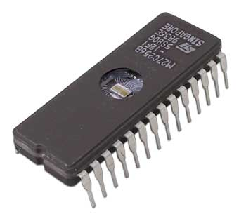
UV EPROM
Erasable PROM
Common technologies used UV light to erase complete device
Took about 10 minutes
Holds state as charge in very well insulated areas of the chip
Nonvolatile for several (10?) years

Slide 17
EEPROM
Electrically Erasable PROM
Similar technology to UV EPROM
Erased in blocks by higher voltage
Programming slower than reading
Some called flash memory
Digital cameras, MP3 players, BIOS
Limited life
Some support individual word write, some block
Has a boot block that is carefully protected

Slide 18
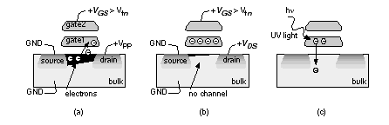
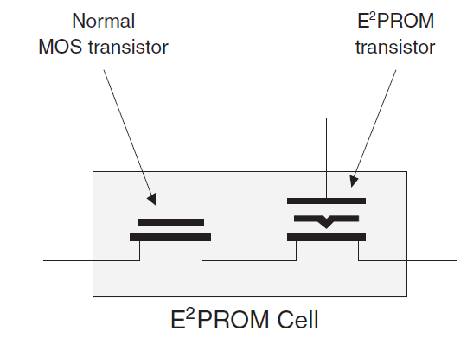
EPROM/EEPROM/Flash
ولتاژ برنامه ريزي بالا ← محبوس شدن الکترونها ⬅ Vdd نمي تواند ترانزيستور را روشن کند
EEPROM: باز گرداندن الکترونها با ميدان الکتريکي (ظرفيت کمتر از EPROM).

Slide 19

SRAM
SRAM
SRAM Cell

Slide 20
SRAM
مزايا:
برنامه ريزي مجدد سريع.
برنامه ريزي on-chip به دفعات نامحدود.
⬅ prototyping در داخل سيکل طراحي
کارخانه ي سازنده مي تواند همه ي مسيرها را با reprogram کردن FPGA تست کند (⬅ کاربر، آي سي کاملا تست شده را مي گيرد و نيازي به ايجاد الگوهاي تست و مدارهاي DFT ندارد).
اشکالات:
مساحت (اشکال اصلي): 5 ترانزيستور براي هر سلول SRAM + يک ترانزيستور براي سوييچ.
نياز به حافظه ي خارجي non-volatile (داراي مدار حسگر power-on است براي initialization).
امنيت کم طرح در برابر سرقت (intellectual property)
توان مصرفي بالاي سلول هاي SRAM (حتي وقتي که برنامة آن تغيير نمي کند).

Slide 21
Programmable Logic Device (PLD)

Slide 22
Three FPLD Types
Simple Programmable Logic Device (SPLD)
LSI device (Less than 1000 logic gates)
PLA or PAL
Fixed internal routing, deterministic propagation delays
Complex Programmable Logic Device (CPLD)
VLSI device (Higher logic capacity than SPLDs)
Multiple SPLDs onto a single chip
Programmable interconnect
Field Programmable Gate Array (FPGA)
VLSI device (Higher logic capacity than CPLDs)
An array of logic blocks
Large number of gates, user selectable interconnection, delays depending on design and routing
A high ratio of flip-flops to logic resources

Slide 23
SPLD

Slide 24
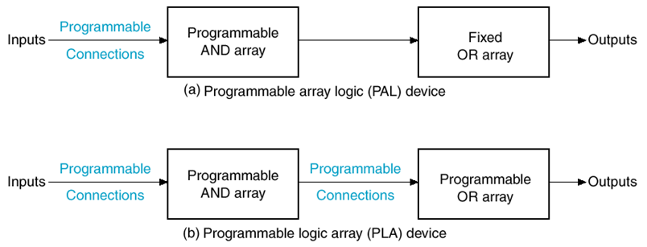
Simple PLD (SPLD)
Popular SPLD Architecture Types
Programmable Logic Array, PLA
Programmable Array Logic, PAL
General Array Logic, GAL
others
Architecture Differences
AND versus OR implementation
Programmability (e.g., EE)
Fundamental logic block

Slide 25
PLA & PAL
Programmable Logic Array
Programmable Array Logic
A PLA has complete flexibility of its sum-of-products groupings.
A PAL has limits on the arrangement of its sum-of-products groupings.

Slide 26
SPLD - PLA
D
C
B
A
SPLDs are good alternative to using SSI and MSI devices
Especially if re-programmable
ABC
ABC
AD
AD
F = ABC’ + AD + A’D
G = ABC + ABC’ + A’D
H = ABC + BD
J = B + AD
BD
B
F
G
H
J

Slide 27
SPLD - PAL
I
1
I
2
I
3
Implement the following:
P
1
P
2
P
3
P
4

Slide 28
SPLD - PAL
x
x
x
1
2
3
P₁
P₂
P₃
P₄
P
1
f₁
P
2
P
3
f₂
P
4
AND plane

Slide 29
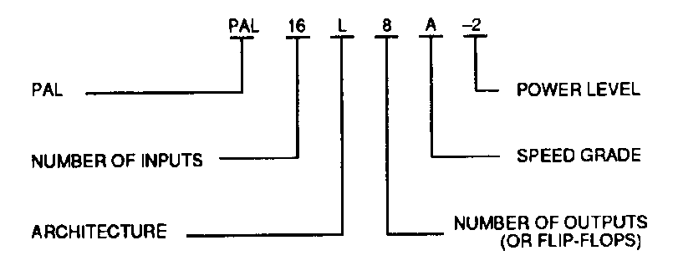
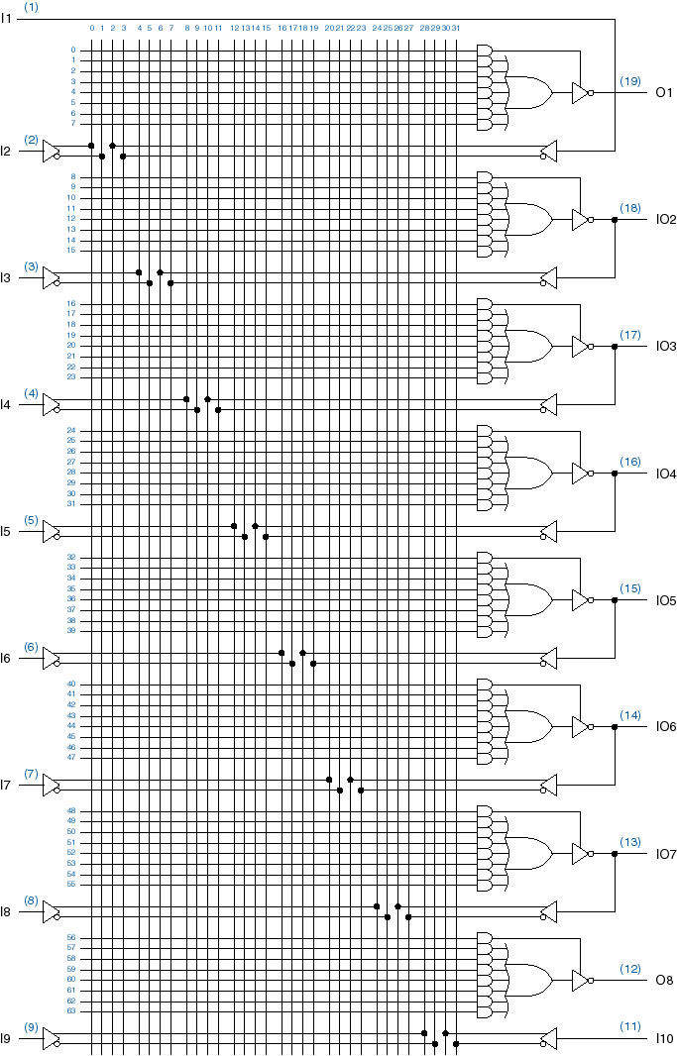
SPLD - PAL
An actual PAL device
PAL16L8
32 input AND gates
up to 8 output functions

Slide 30
PAL Outputs
Typical PALs have:
from 10 to 20 inputs
from 2 to 10 outputs
from 2 to 8 AND gates driving each OR gate
often include D flip-flops
Select
Enable
f
1
Flip-flop
D
Q
Clock
To AND plane
MUX output is “fed back” to the AND plane.

Slide 31
PAL Product Terms
B B’A A’ C C’ D D’ I I’ J J’ E E’ F F’ K K’GG’H H’
This looks like an AND gate with one input. It is actually many more:
B
B’
A
Drawn with a single line (above) to save space.
A’
P
C
C’
H
H’

Slide 32
PAL Example
A
G
B
H
C
I
D
J
P
P’ = A’BGH’ + CD’ + HIJ + BG’H

Slide 33
CPLD

Slide 34
CPLD
PALs and GALs are available only in small sizes
equivalent to a few hundred logic gates
For bigger logic circuits, complex PLDs or CPLDs can be used.
CPLDs contain the equivalent of several PALs/GALs
linked by programmable interconnections
all in one integrated circuit (IC)
CPLDs can replace thousands, or even hundreds of thousands, of individual logic gates
increased integration density

Slide 35
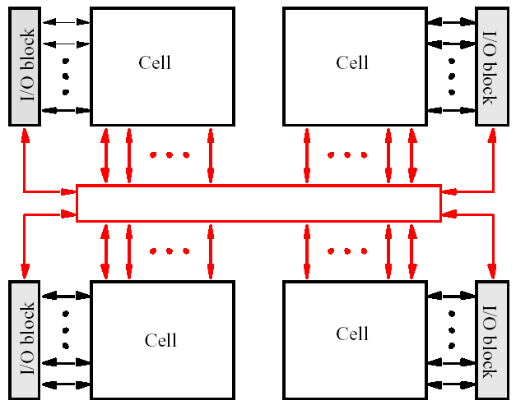
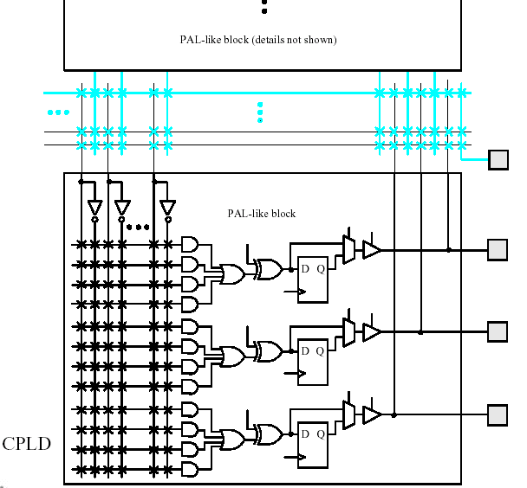
CPLD

Slide 36
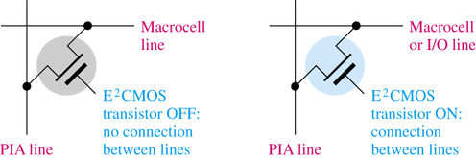
Programmable Interconnect Array
Consists of connectors that run throughout the CPLD to connect the macrocells in each LAB
The PIA also connects the AND gate and other elements of the macrocells

